Slide 1
Video Quality and Interoperability across Videophones Today and in the Future
Christian Vogler and Norman Williams
Technology Access Program, Gallaudet University
NAD Conference, Louisville KY, July 3-7, 2012

Slide 2
Overview
Who we are
The state of video calling today
Interoperability of videophones
Video quality
A look into the future
Technical standards and mainstream video calling
Better access to 9-1-1

Slide 3
Who we are
The Technology Access Program is a deaf-led research center at Gallaudet University
Research areas:
Telecommunications access
Videoconferencing access
9-1-1 access
Hearing aid compatibility of phones
And other technology access issues

Slide 4
Video calling today
What devices do you use for video calls?
Stand-alone videophone (e.g. VP-200, NTouch, Z-20, Z-340, Ojo, …)?
Your laptop or desktop computer?
Your mobile phone, pager, or tablet?

Slide 5
Video calling today
What software do you use for video calls?
VRS app on your computer or mobile
Skype
ooVoo
Tango
Fring
FaceTime
Other?

Slide 6
Video calling needs?
What devices would you like to use for video calls?
Stand-alone videophone?
Your laptop or desktop computer?
Your mobile phone, pager, or tablet?
Something else?

Slide 7
Video calling needs?
What software would you like to use for video calls?
VRS app on your computer or mobile
Skype
ooVoo
Tango
Fring
FaceTime
Other?

Slide 8
Video calling today
It is worth remembering what the purpose of VRS and videophones is: Functional equivalence
Can deaf and hard of hearing people use telecommunication services in the same unrestricted manner and at the same costs as hearing people?

Slide 9
Functional Equivalence
Do we have it today?
Do you feel that we have equal access compared to the mainstream?

Slide 10
Interoperability
Interoperability is a big barrier for us in the video calling world.
Interoperability: devices from different vendors and providers work with each other.
See what hearing callers can do:

Slide 11
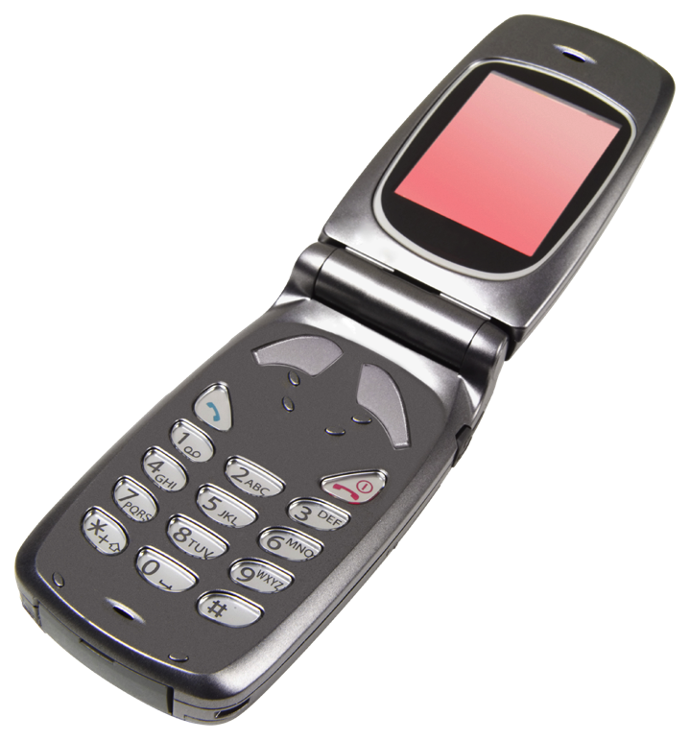
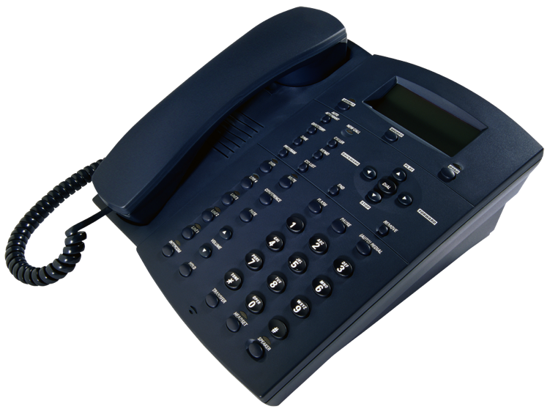
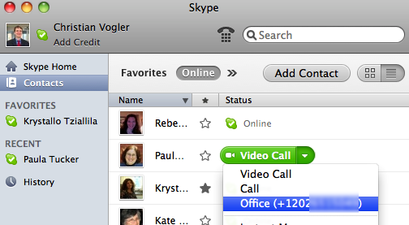
Voice interoperability
Hearing callers can call each other with landline phones, mobile phones, Internet software, and leave messages via answering machines/voicemail. It just works.

Slide 12
Video interoperability
Video interoperability isn’t as good
Many VRS apps and phones still can’t call each other
We ran tests to find out -

Slide 13
Interoperability testing
Tested devices, software and apps from 5 major VRS providers: Sorenson, ZVRS, Purple, SnapVRS, and Convo
Tested only devices and software that are available to new customers

Slide 14
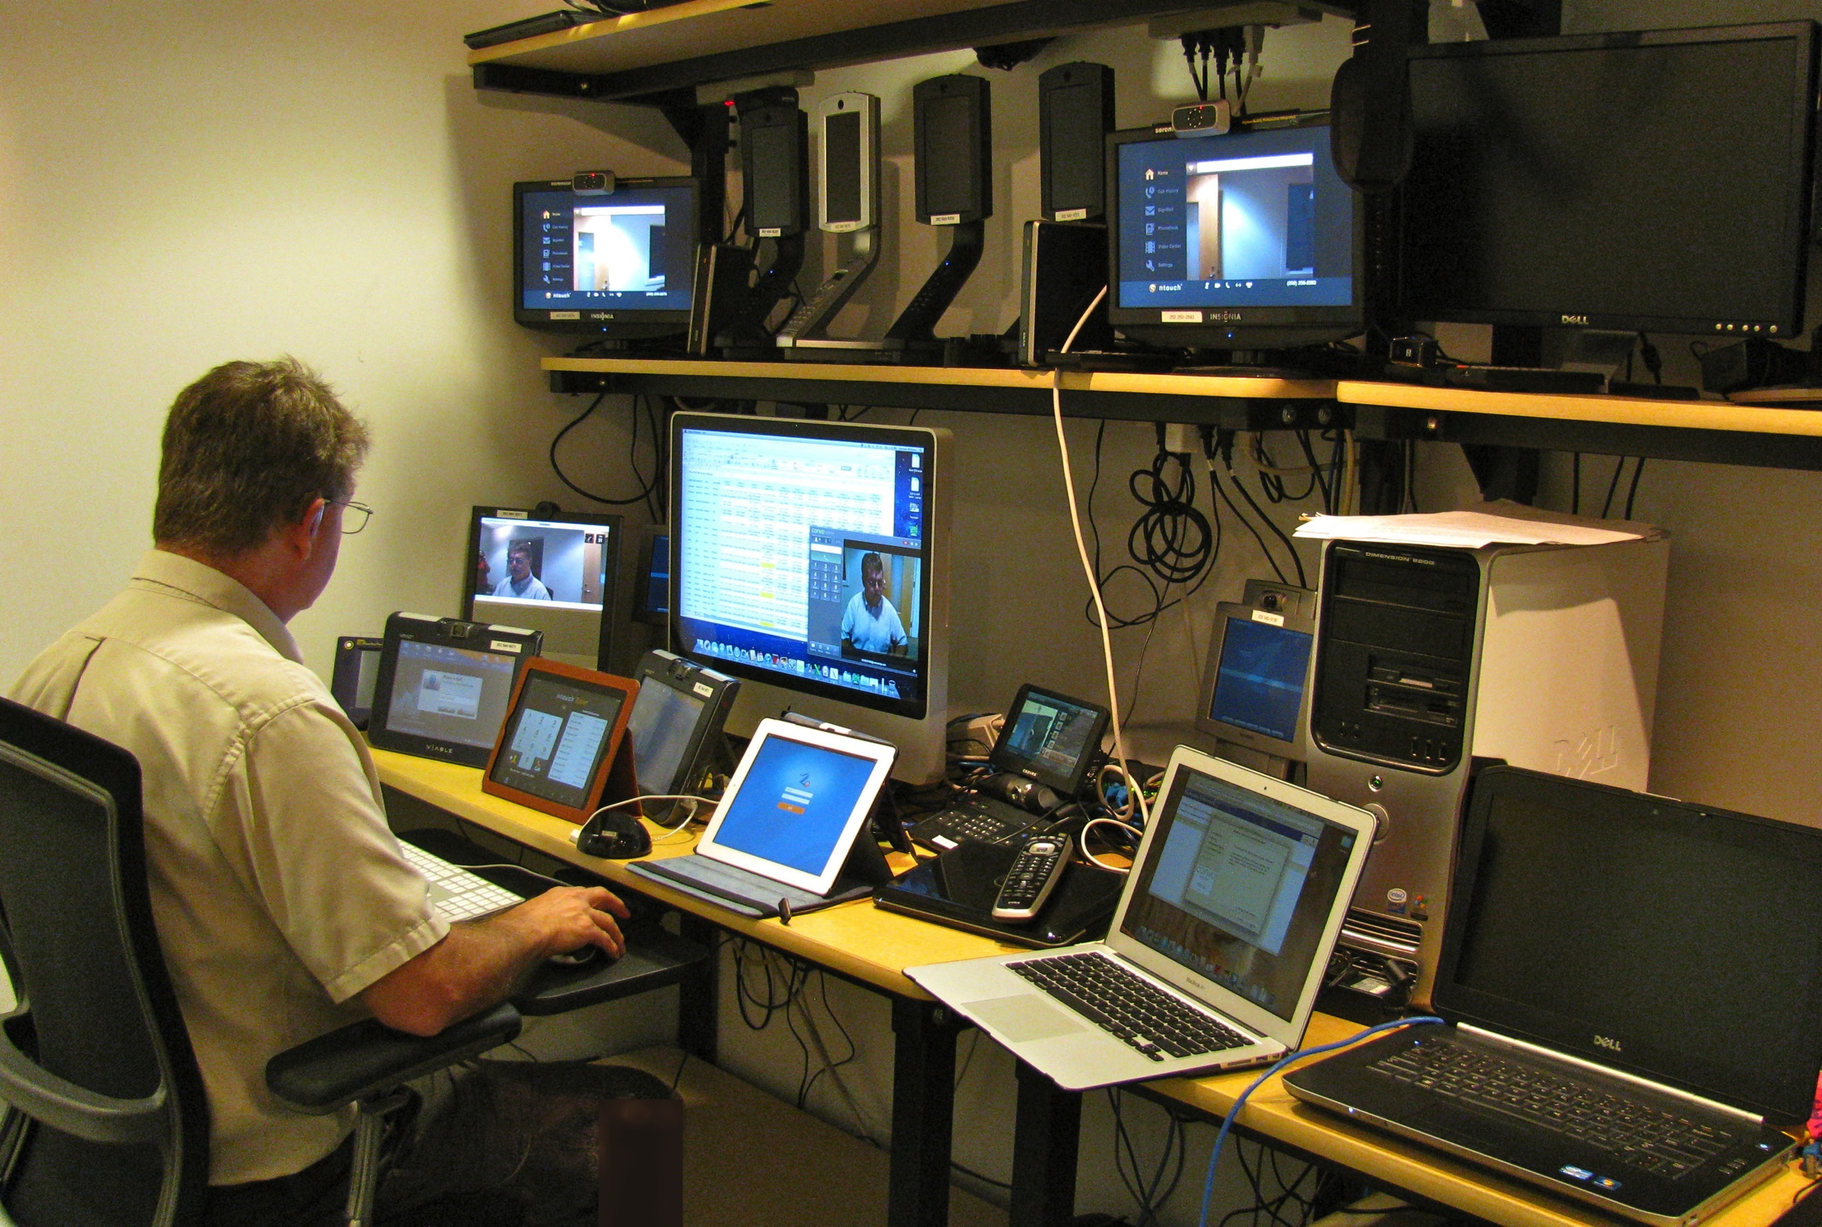
Testing environment

Slide 15
Testing method
Test live call from and to each device
Test leaving message on answering machine
Press “reject call” on answering phone to force answering machine on
One limitation: Some phones may behave differently if you just let the call ring – but this would have taken too long
21 devices on each side, 882 calls total; took 2 weeks to complete

Slide 16
Interoperability Results
Full results are in the spreadsheet on our web site: http://tap.gallaudet.edu/Conferences/NAD2012/
Some highlights:

Slide 17
Interoperability Summary
Stand-alone VPs and computer software work better than mobile devices
Live calls work better than leaving messages

Slide 18
Interoperability: Sorenson
Sorenson:
The stand-alone nTouch VP is compatible with many non-Sorenson products
nTouch PC and the mobile clients do not work with non-Sorenson products
Stand-alone nTouch VP can leave messages on most non-Sorenson products, but not vice versa
If the answering machine does not work, you may get a busy signal – it does not always mean that the person is using the phone

Slide 19
Interoperability: ZVRS
ZVRS:
Generally works well with most other products for live calls
Can take incoming messages from most products
Problems with leaving messages on Purple answering machines; bug has been reported and may already have been corrected

Slide 20
Interoperability: Purple
Purple:
Works well with most other products for live calls
Some problems with taking messages on answering machine – calls ring, but never connect to the answering machine.
Possibly due to a problem with sharing an account across multiple devices in our test setup
Purple and Convo products have problems talking to each other
Purple iOS client has problems if the Purple user rejects a call – the call does not go to the answering machine. Bug has been reported.

Slide 21
Interoperability: SnapVRS
SnapVRS:
Tested only the Ojo stand-alone videophone
Generally works with other vendors’ products
Can take incoming messages from most products, some problems with taking messages from Purple products

Slide 22
Interoperability: Convo
Convo:
Can leave messages on most other products’ answering machine
Cannot take incoming messages – no answering machine
Convo and Purple products have problems talking to each other

Slide 23
Types of problems
Videophone does not ring
… you have no idea that someone called
Black/green screen
… the caller can’t see you or vice versa
Call gets disconnected
… you can’t finish your conversation
Answering machine does not work
… people can’t leave messages for you

Slide 24
About mobiles …
Interoperability is worse than with standalone VPs and computer software
Data bandwidth and data caps (2 GB is just 2-4 hours of calling time)
With some iPhone and iPad VRS apps, the receiving side does not get the best video compression codec (H.264)
this means that they use twice as much data as other devices to get similar video quality
It takes months before new Android devices are supported – if at all
Some apps drain your batteries very quickly

Slide 25
Interop: Consequences
All this means:
We still need more than one videophone or software application to keep in touch with all of our friends and family
It is dangerous to rely on the answering machine, especially if you try to run a business via your videophone
We still don’t have good ways to make mobile calls

Slide 26
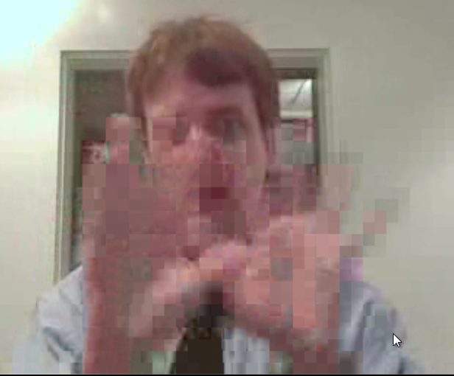
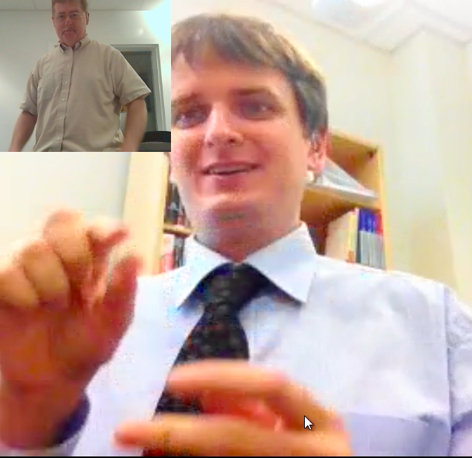
Video quality
Video quality is a confusing topic.
Lots of misinformation, and even the FCC and VRS companies do not always get it right

Slide 27
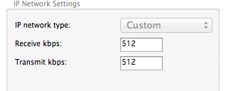
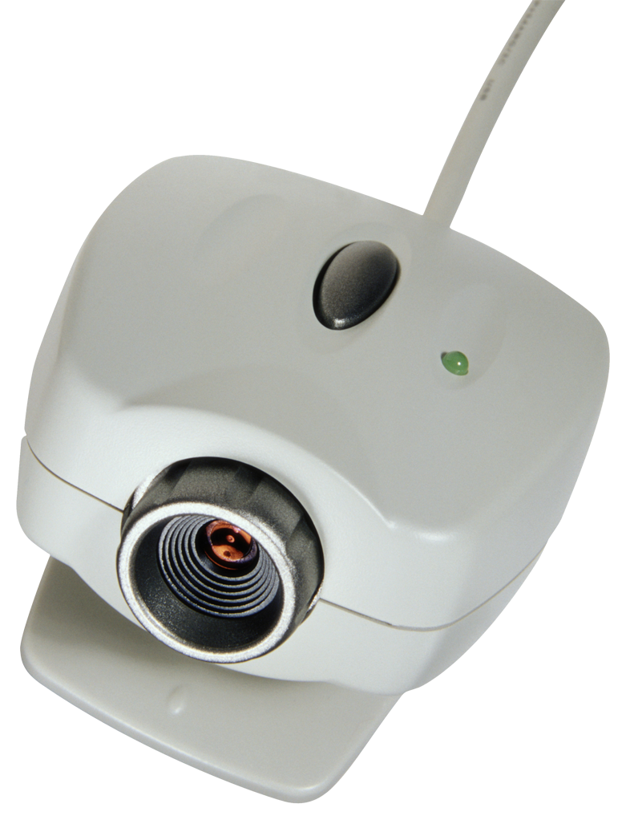
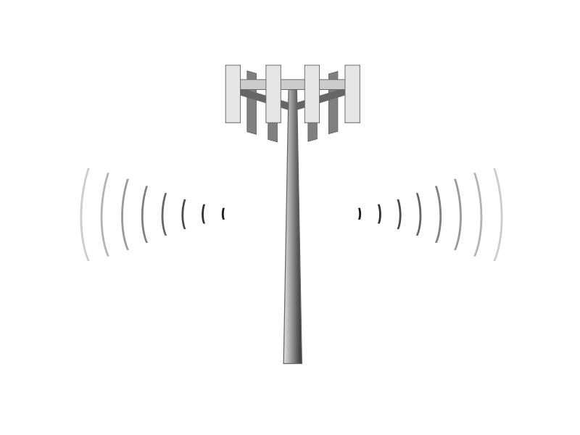
What affects quality?
WiFi signal
VP network settings
Camera
Internet connection
Mobile network

Slide 28
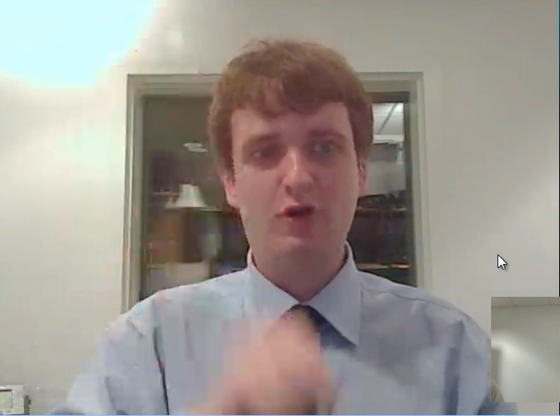
Example video - 1

Slide 29
Example video - 1
Possible Explanations:
Bad camera
Network speed is slow
Or a combination of both
How to solve:
Faster Internet plan
Get a good USB camera

Slide 30
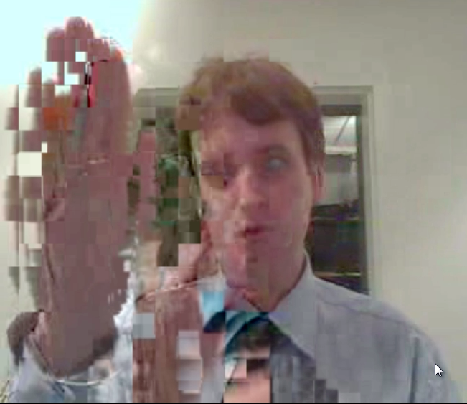
Example video - 2

Slide 31
Example video - 2
Possible Explanations:
VP network settings are too high
WiFi interference
Network congestion
Too many mobile users in the area
How to solve:
Use lower VP network settings
Faster Internet plan
Switch your WiFi router to a different channel
Use wired Ethernet
Switch from 3G/4G mobile to WiFi

Slide 32
Example video - 3

Slide 33
Example video - 3
Possible Explanations:
Mobile network fluctuates
Network congestion
How to solve:
Lower the VP network settings
Switch from mobile network to WiFi or Ethernet
Faster Internet plan

Slide 34
Example video - 4

Slide 35
Example video - 4
Possible Explanations:
Some mobile devices don’t send the highest-quality video (H.263 instead of H.264)
How to solve:
Wait for a faster mobile device
Ask your VRS provider why the mobile app does not send H.264
Use a different device (e.g. a laptop instead of a tablet or phone)

Slide 36
What is what?
Example video 1: Skype, 256 kBit/s network bandwidth
Example video 2: Two laptop VRS apps from different vendors, 256 kBit/s network bandwidth, one VP incorrectly set to 384 kBit/s
Example video 3: VRS app on iPad over Verizon 4G LTE to laptop, 256 kBit/s
Example video 4: VRS app on iPad over Verizon 4G LTE to laptop, 512 kBit/s

Slide 37
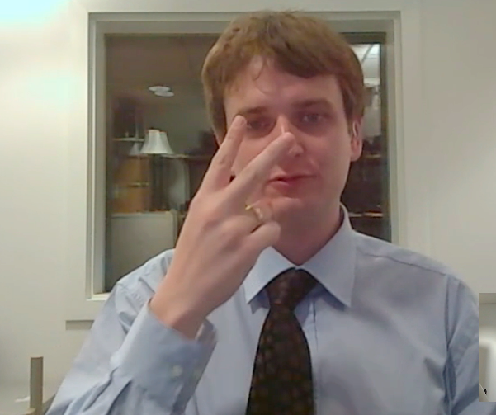
More examples
Which videos have acceptable quality? Raise your hand.

Slide 38
What is what?
nTouch VP to nTouch PC, 192 kBit/s
nTouch VP to nTouch PC, 256 kBit/s
nTouch VP to nTouch PC, 512 kBit/s
Z4 to Z4, 256 kBit/s
Z4 to Z4, 512 kBit/s
Z4 to P3, 256 kBit/s
Z4 to P3, 512 kBit/s
Sorenson nTouch iPad to nTouch PC, Verizon 4G LTE 512 kBit/s
Skype unlimited bandwidth

Slide 39
The biggest mistake
The biggest mistake people make is to use the wrong network setting in their VP:
Too high? You can forget about the conversation!
Too low? The video is less clear, but you can still talk.
The setting must be lower than the bandwidth: if you have a 256 kBit/s upload speed, you should choose 192 kBit/s in the VP.
Why do people have to mess with this setting anyway? It’s too complicated!
This should be automatic (like with Skype)
Complain to your VRS provider and the FCC

Slide 40
The 256 kBit/s myth
Some VRS companies and the FCC have said that 256 kBit/s minimum network speed may be enough
Not really: this would require a 192 kBit/s setting in the VP (see previous slide)
192 kBit/s gives poor video quality
Ask for a plan with 384 kBit/s or more upload and download speed
If you don’t need it, turn off audio

Slide 41
Future of VRS
New technical standards
Interoperability
Mainstream calling and equipment
Total conversation (video, real-time text, audio)
Next-generation 9-1-1

Slide 42
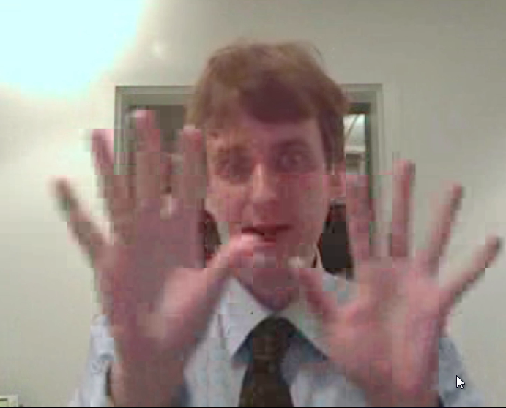
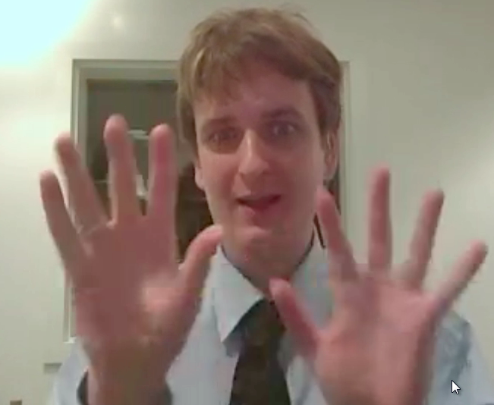
Technical Standards
You may have noticed: Video quality between VPs from the same vendor is much better than across vendors
For the same vendor they use the better quality H.264 codec, while across vendors they use lower-quality H.263
Across vendors
Same vendor

Slide 43
Technical Standards
The FCC’s proposal for VRS reform:
Would make higher-quality video part of the standards
Would improve interoperability across VPs
Would improve interoperability with mainstream video calling equipment and software

Slide 44
Mainstream calling
Imagine: If you could use any video calling equipment with VRS?
You could call friends, family, colleagues – deaf or hearing – all with the same equipment
This is important, because:
Less confusion about what works and what doesn’t
Hearing people can’t get VRS equipment
Companies like to use standard equipment
VRS apps on mobiles are months late
Better access to 9-1-1

Slide 45
Total Conversation
Video, audio, and (real-time) text in any combination
You decide how to communicate
Advantages of interoperable text channel:
Type information that is hard to fingerspell
Better access for deaf-blind: interpreter can type back
Better access for people who find it hard to sign but can understand ASL fine

Slide 46
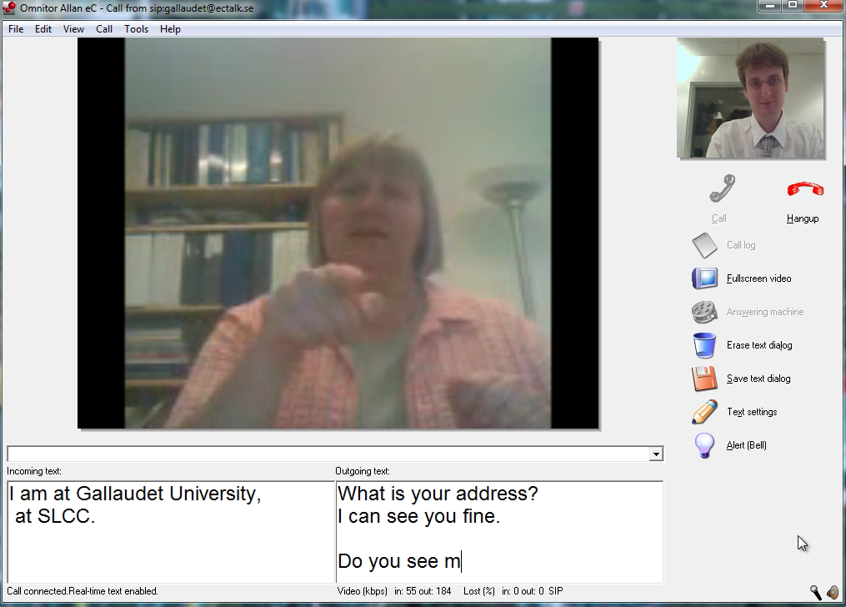
Total Conversation

Slide 47
Next-gen 9-1-1
Total conversation is at the heart of next-generation 9-1-1 services
Next-generation 9-1-1 also will allow direct video between you, the emergency responder, and a sign language interpreter

Slide 48
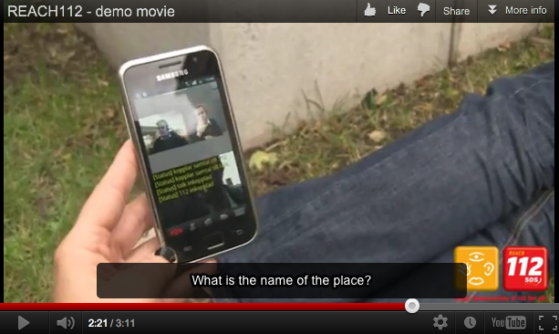
Next-gen 9-1-1
Demo of 3-way future 9-1-1 call

Slide 49
Acknowledgments
The contents of this presentation were developed with funding from the National Institute on Disability and Rehabilitation Research, U.S. Department of Education, grant number H133E090001 (RERC on Telecommunications Access). However, those contents do not necessarily represent the policy of the Department of Education, and you should not assume endorsement by the Federal Government.
We are grateful to Verizon Wireless for lending us LTE equipment for testing.
Paula Tucker was an invaluable help with assembling the presentation.

Slide 50
Questions
Questions? Comments?
Supplemental material: http://tap.gallaudet.edu/Conferences/NAD2012/

